Slide 1
Free CAN Communication
FSE RACING KIT
Notes:
DE/EN abgeglichen 16.02.2022

Slide 2


Free CAN Communication
Characteristics:
CAN 2.0 A bus supports the 11-bit identifier format ('base frame format')
Any CAN identifier
Transmission in Intel format
Up to 10 send messages which can contain up to 10 signals
Up to 10 receive messages each containing up to 10 signals
Transmission of SPECIAL signals
Transmission of SERCOS parameters
Limitation data range of a signal
Cyclic transmission, variable output rates in 1 ms steps
Event-controlled transmission, variable delay time in 1 ms steps
Variable transfer rate
Inverted control signal for the plausibility check
of setpoints and actual values
Telegram failure monitoring
Message counter
Checksum

Slide 3
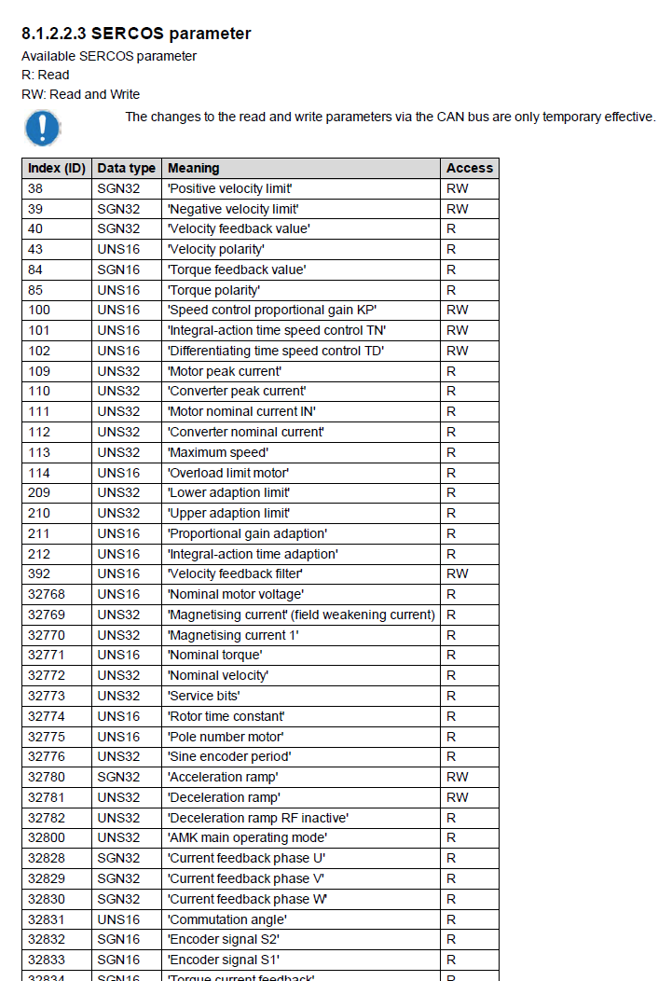
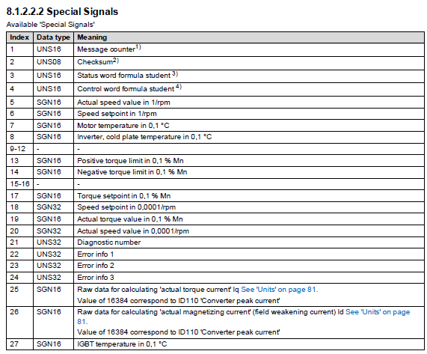
Possible Parameters
The CAN message configuration
can be freely configured with defined
special signals and SERCOS parameters.
See device description:
Formula Student Racing Kit

Slide 4
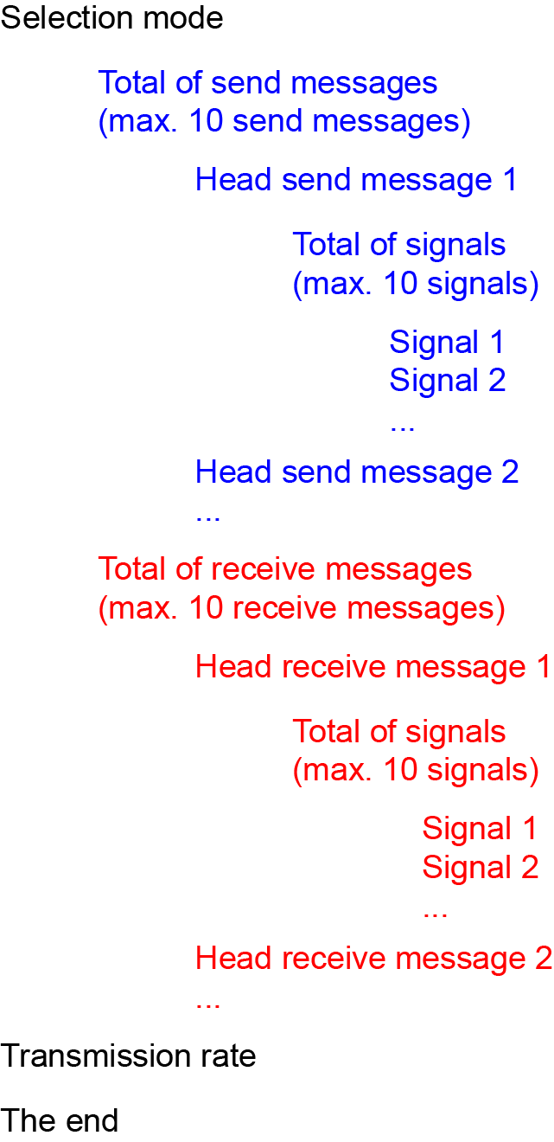
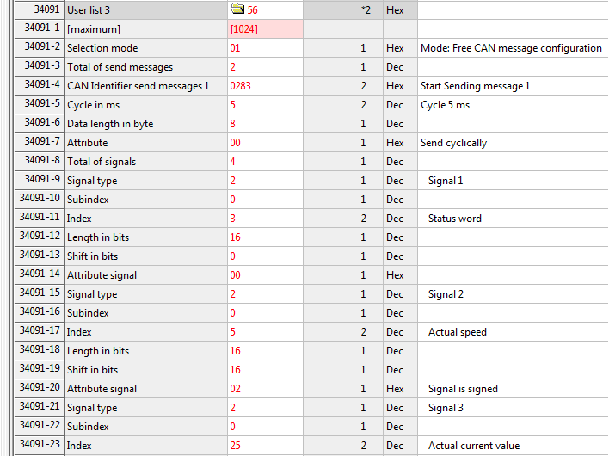
Structure CAN Configuration
The structure ID34091 'User List 3' of the CAN configuration is done by a fixed sequence

Slide 5

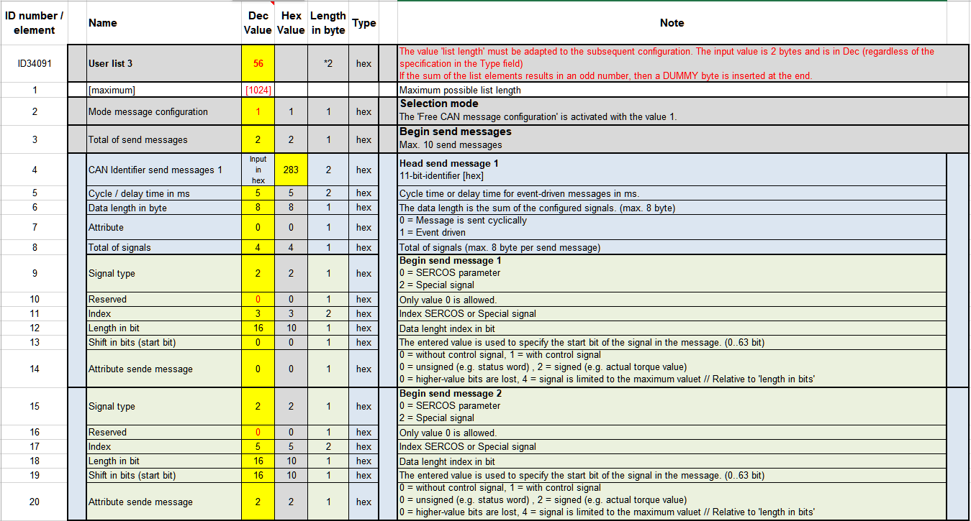
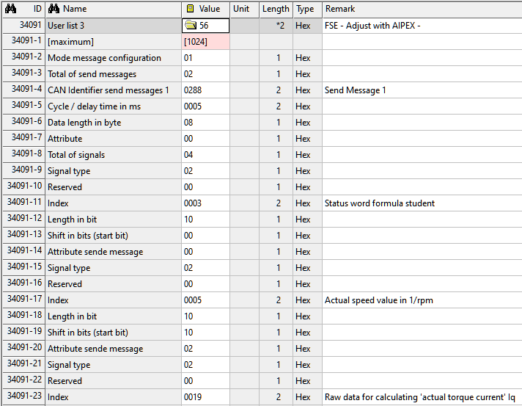

Configuration Help
Create configuration in Excel and copy paste it into the AIPEX project.
Siehe Trainingsunterlagen:
Training RACING KIT DE V01 2022 / AIPEX PRO Beispiele

